Slide 1




PROJECT PRESENTATION
TEAM ERROR BRO'S
DEEPAK P M
DINESH PANDY D
BHOOMIKA S E
KEERTHANA S
PRASANAKUMAR R
GOKUL T

Slide 2
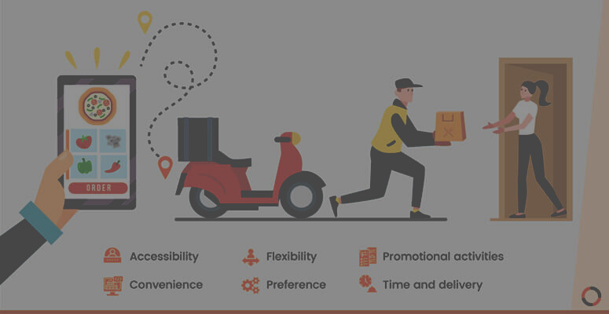


Welcome To Our
Project....
Online food ordering is the process of ordering food, for delivery or pickup, from a website or other application. The product can be either ready-to-eat food (e.g., direct from a home-kitchen, restaurant, or a virtual restaurant) or food that has not been specially prepared for direct consumption (e.g., vegetables direct from a farm/garden, fruits, frozen meats. etc).
The first online food order was a pizza from Pizza Hut in 1994.
"Online ordering has started to become the norm, thanks to
convenience, accuracy, and ability to integrate payments.
At scale, ubiquitous on-demand and subscription delivery
of prepared food could potentially spell the end of cooking at home.”

Slide 3

NOW OPEN
About Us
The Online Food Order System is a simple project developed using HTML,CSS and JavaScript.For the user section, the users can go through the homepage, about, and contact pages. In order to order the food items, the user has to create an account and sign in or log in. The food comes with the cost as well. This project makes a convenient way for customers to buy/purchase food online, without having to go to the restaurant.

Slide 4

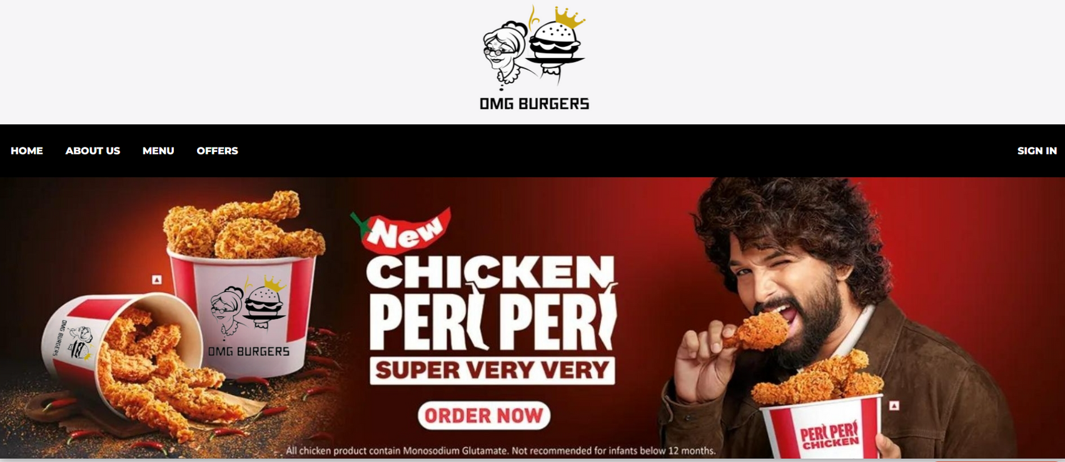

HOME

Slide 5
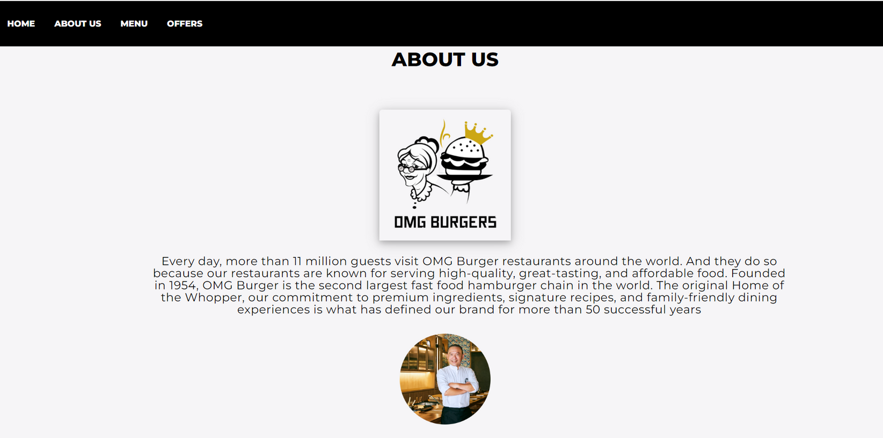
ABOUT

Slide 6
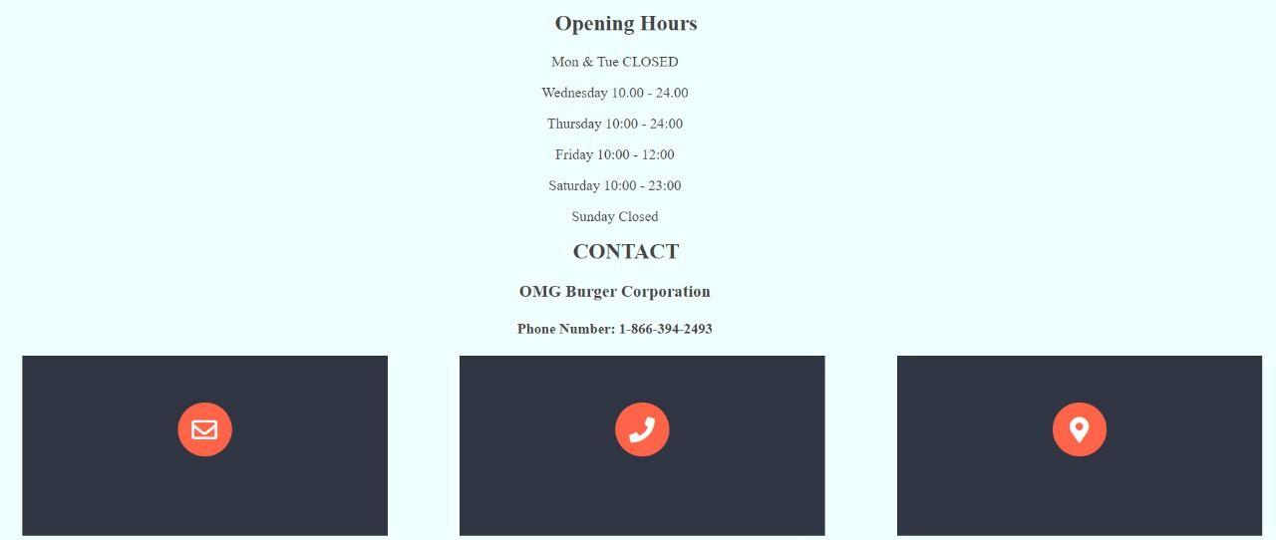
CONTACT

Slide 7
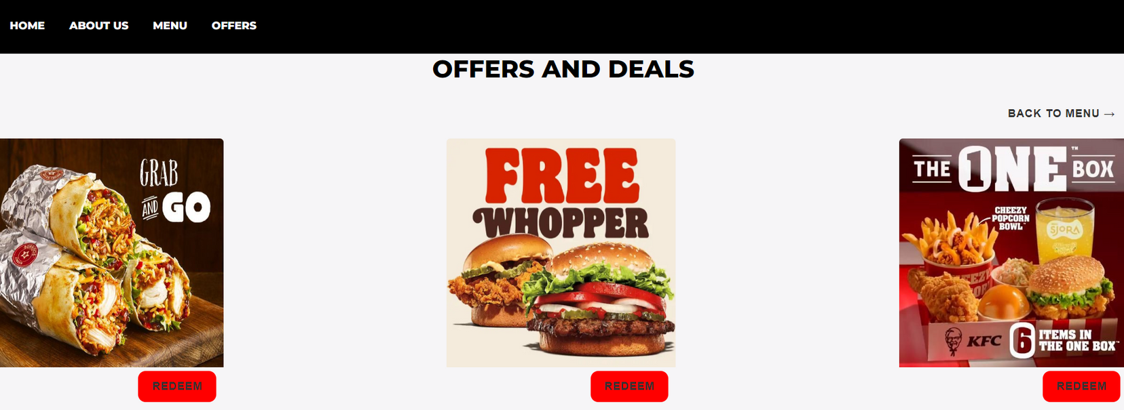
OFFERS

Slide 8
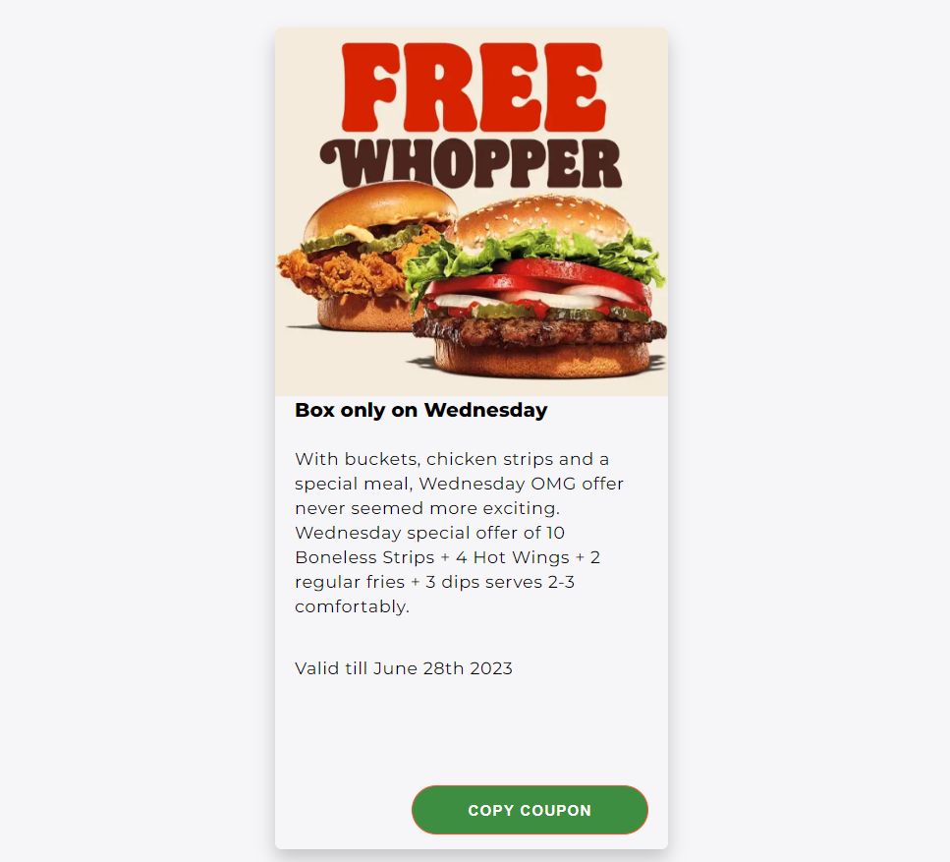
COUPON

Slide 9
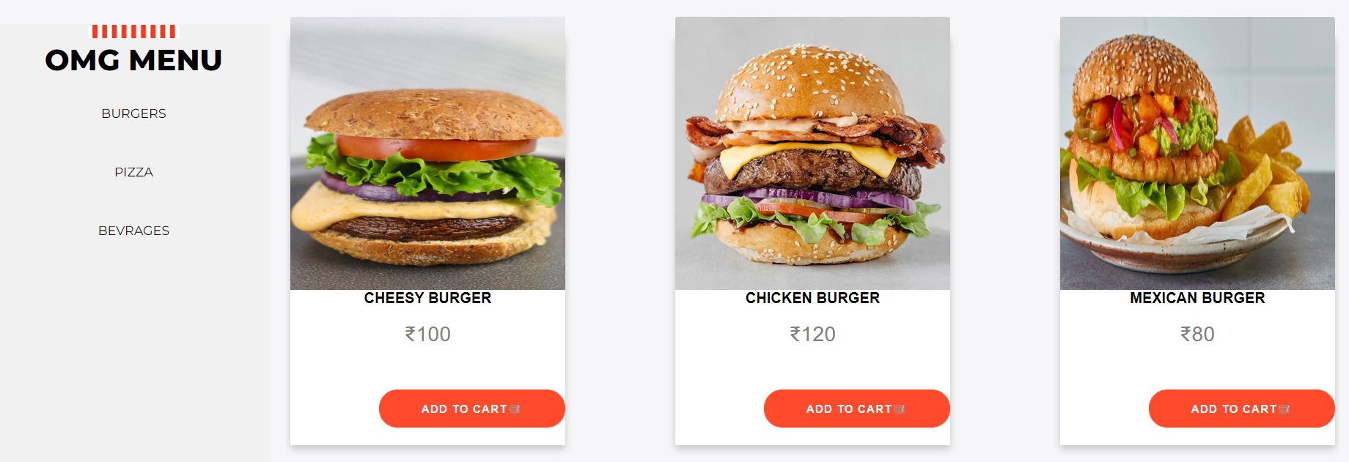
MENU

Slide 10
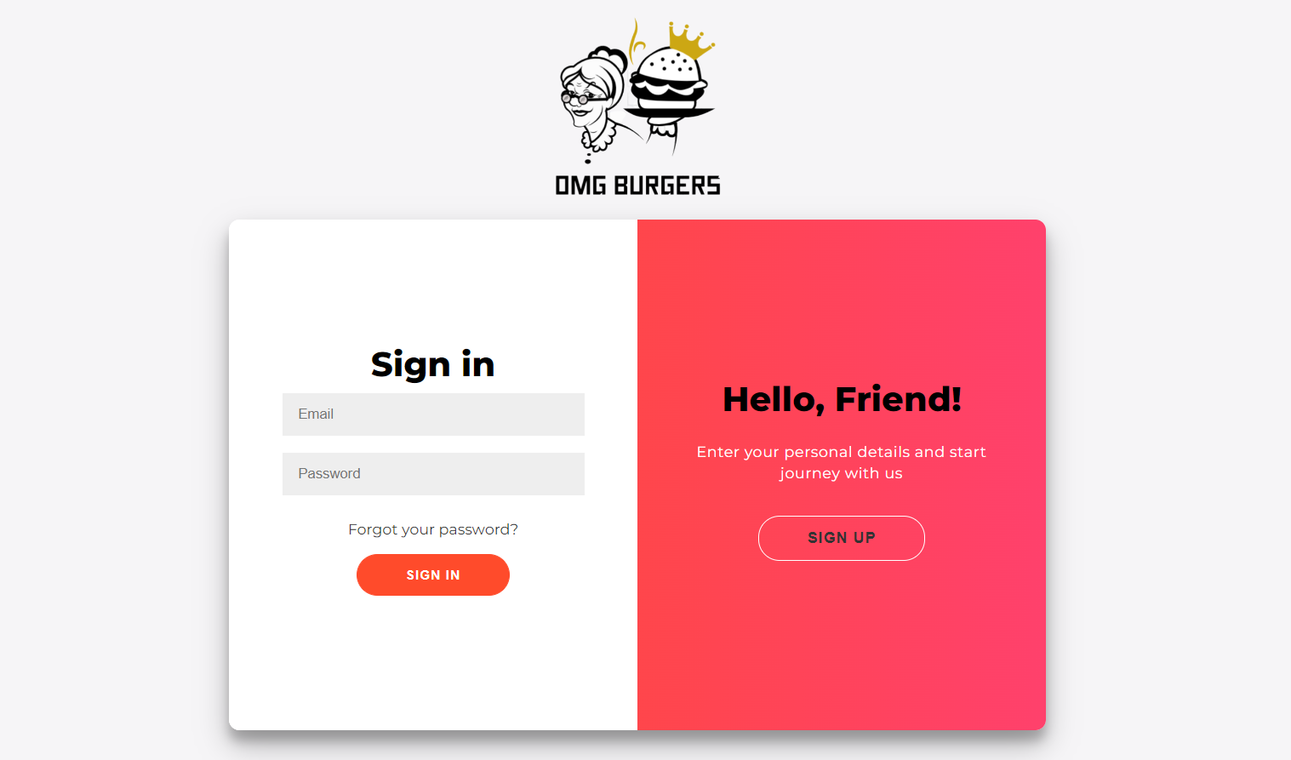
SIGN IN

Slide 11
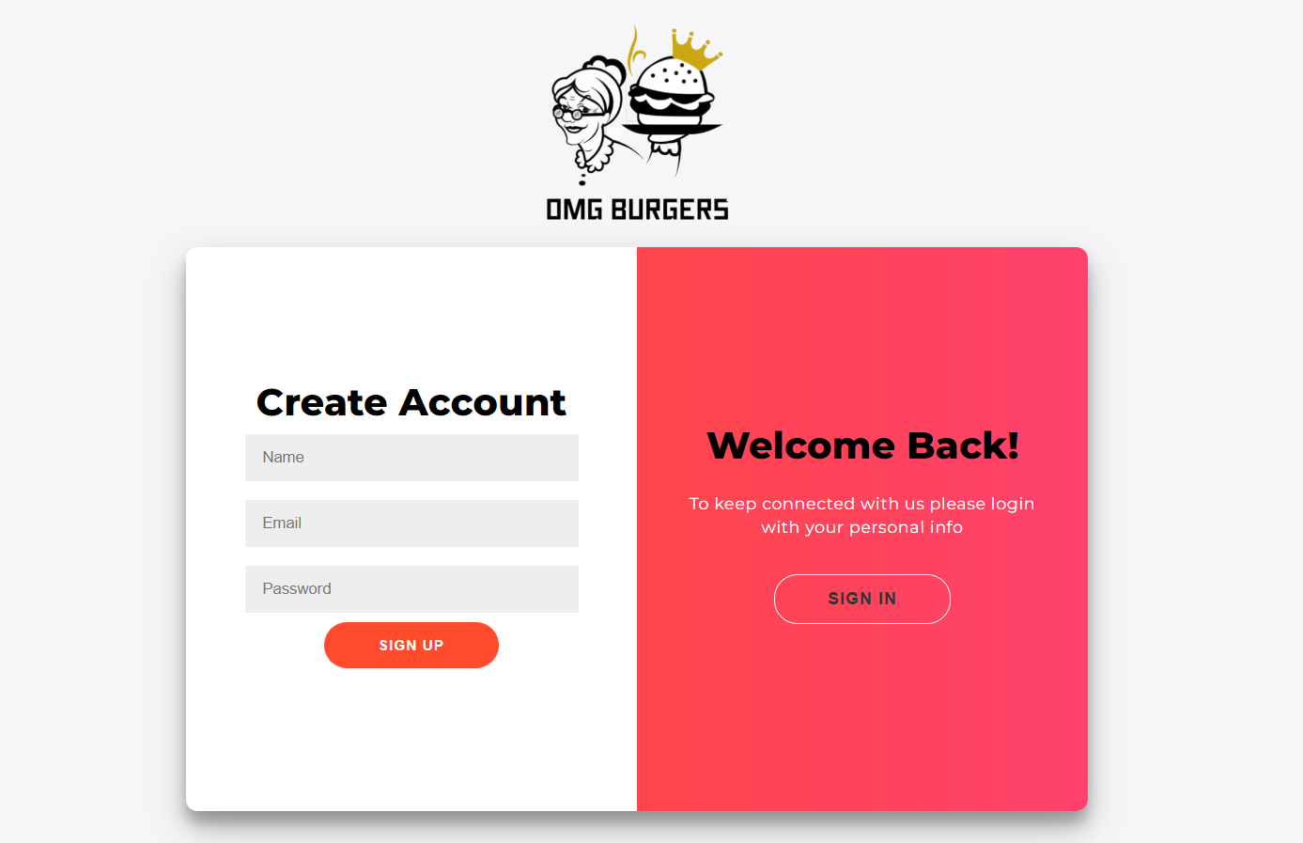
SIGN UP

Slide 12

FOOTER

Slide 13
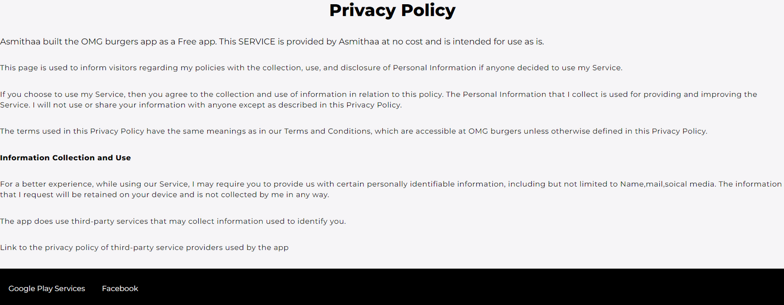
PRIVACY POLICY

Slide 14
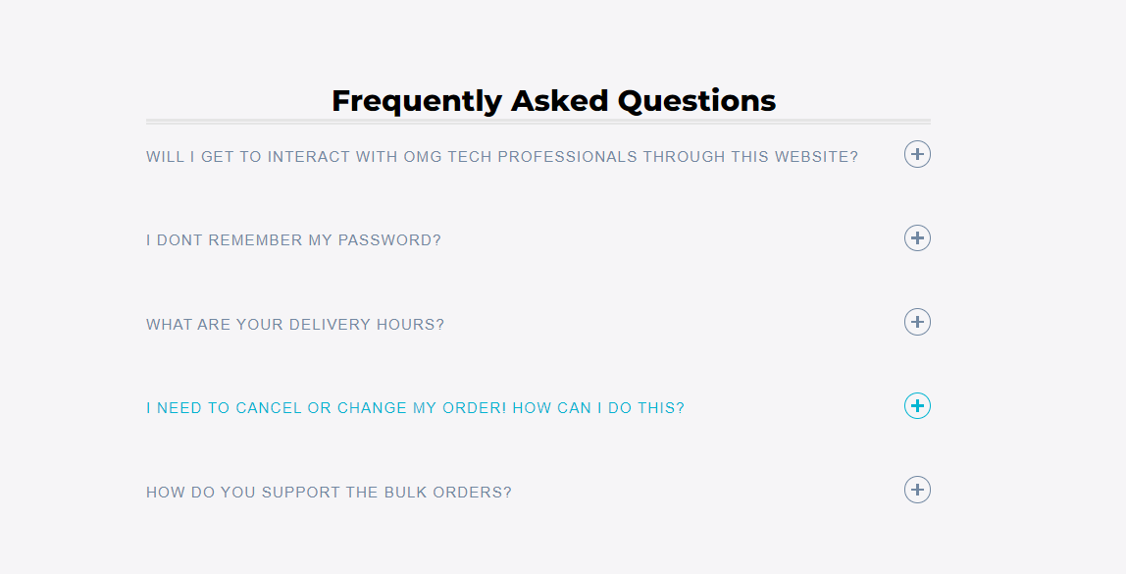
FAQ's

Slide 15
THANK
YOU

